Slide 1
Livingston County Children’s Network: Community Scorecard
2016

Slide 2
Our community needs:
Risk Behaviors:
Drug & Alcohol use
Truancy & Drop-out
Obesity & Body image
Teen pregnancy
Self-injury& suicidal thoughts
Bullying & Violence
Risk Factors:
Family Instability
Family Mobility
Parent Availability
Parenting Skills
Poverty
Stigma associated with help-seeking
Increasing mental health needs of adults and kids
Protective Factors:
Lack of trusting/nurturing relationships
Lack of structure/supervision for youth (youth center, afterschool care, mentoring)
Lack of quality child care

Slide 3
STRUCTURE
Leadership Team
Early Childhood
Medical
Executive Council
Mental Health
(Tier IV)
School
Professional Education
Program Evaluation
Community Education

Slide 4
LCCN Goals & Objectives
1. Increase capacity of system of care
  Enhance number of providers & skills, address service & funding gaps
2. Increase accessibility of services
  Increase awareness of services
  Eliminate barriers (stigma, payment, transportation)
3. Increase coordination of services
  Improve collaboration & communication among providers
  Use data for decision making
4. Decrease rates of risk behaviors and frequency & severity of mental disorders
  Enhance SEL & early identification
  Improve protective factors (e.g., child-adult relations)
Notes:
Increase capacity of system of care
A. Increase workforce to meet needs
B. Increase skills of current personnel
C. Fill identified service gaps
D. Identify funding sources
2. Increase accessibility of services
A. Identify barriers to utilization
B. Decrease stigma barrier
C. Decrease financial barrier
D. Decrease transportation barrier
E. Increase awareness of services & how to access them
3. Increase coordination of services
A. Promote linkages to the medical home
B. Increase likelihood of successful transition from one setting/provider to another
C. Increase collaboration between providers serving same clients
D. Utilize data to evaluate process & outcomes
4. Decrease rates of risk behaviors and frequency & severity of mental disorders
A. Promote child & adolescent social- emotional skill development
B. Nurture protective factors (e.g., adult-child relationships & school engagement)
C. Identify and support at-risk children & adolescents

Slide 5
Four levels of care for 0-18;
Coordinated across settings
Tier I: Universally available education; prevention
  screening
Tier II: Targeted intervention for at-risk (promote pro-social and/or prevent problems)
Tier III: Individual treatment for diagnosed child (natural setting)
  Comprehensive, inter-disciplinary assessment
Tier IV: Intensive individual & family Tx

Slide 6
Celebrating progress towards the fulfillment of our vision:
Families all across Livingston County will utilize and value a comprehensive continuum of services to promote children’s social and emotional development which will, in turn, effectively reduce at-risk behaviors and strengthen relationships.

Slide 7
We want to be sure ALL our children are on track. In 2015, we completed 11,556 screens for social-emotional-behavioral concerns!
Screening occurs in primary care/health dept, the courts & schools

Slide 8
The percentage of children who are at-risk for social-emotional-behavioral concerns is decreasing!

Slide 9
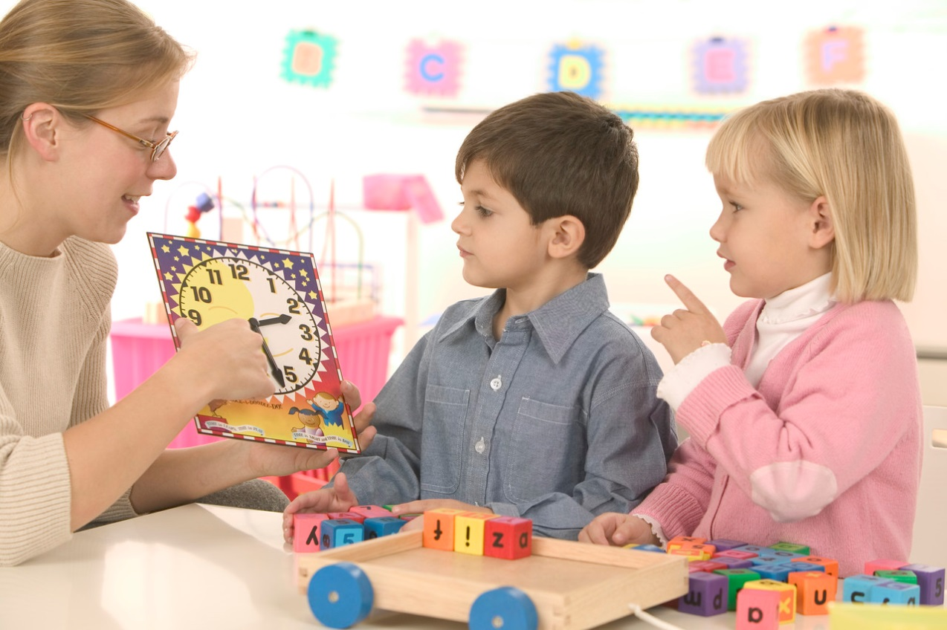
This decrease suggests that our prevention and early intervention strategies are working.
94% of children are in classrooms with Positive Action© teachers.

Slide 10



70-80% of at-risk children and youth receive individual or group services at school.

Slide 11
Many more families who need parenting supports are accessing them.

Slide 12
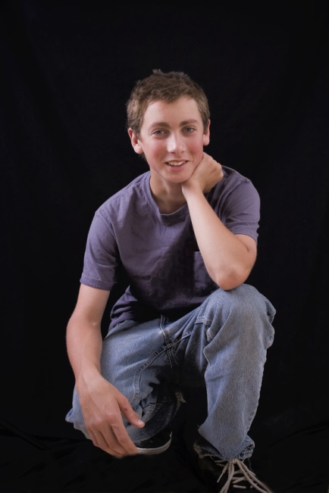
The number of children and adolescents provided therapy by Institute for Human Resources (IHR) has nearly tripled.

Slide 13
Even our Juvenile Police Reports are decreasing... further evidence of our progress.

Slide 14
The community is committed to our children’s health and well-being. Together we can secure the needed funds to continue all components of the Livingston County Children’s Network.

